Slide 1

BACHELOR OF COMPUTER APPLICATION
Machine Learning-Based Prediction of Academic Stress
Among Undergraduate Students in Nepal
Santosh Shrestha • Saroj Lamichhane
Xavier International College, Tribhuvan University, Nepal
BCA Final-Year Research Project
Supervisor: Sulav Shrestha
Notes:
"Good morning, respected supervisors, faculty members, and guests. We are Santosh Shrestha and Saroj Lamichhane. Today we present our BCA final-year project, titled 'Machine Learning-Based Prediction of Academic Stress Among Undergraduate Students in Nepal.' This work was carried out under the supervision of Mr. Sulav Shrestha at Xavier International College, Tribhuvan University."

Slide 2
01
Agenda
01
02
03
04
Context
Research question
Objectives
Methodology
05
06
07
08
Data & pipeline
Models & results
Prototype
Conclusions
BCA FINAL-YEAR DEFENSE • XAVIER INTERNATIONAL COLLEGE
02
Notes:
"Our presentation has eight parts: the context and problem, our research question, objectives, methodology, data and pipeline, models and results, the synthetic validation experiment, explainability and the Streamlit prototype, and finally our conclusions and future work."

Slide 3
02
Introduction and Background
Academic stress is measurable.
10
Student wellbeing can be examined through routinely collected demographic, academic, lifestyle, psychosocial, and stress-assessment information.
stress-assessment questions
on a 1–5 scale
BCA FINAL-YEAR DEFENSE • XAVIER INTERNATIONAL COLLEGE
03
Notes:
"Academic stress is a significant and measurable challenge among undergraduate students. Students face pressures from academic workload, examinations, financial concerns, career uncertainty, and personal responsibilities. Prolonged stress can affect performance, sleep, and mental health.
In this study, we collected 39 genuine survey responses from undergraduate students in Nepal. Each respondent answered ten stress-assessment questions on a five-point scale, along with questions about demographics, academic habits, lifestyle, and psychosocial factors.
Our goal was to investigate whether this kind of routinely collected student information can be used to predict academic stress levels — and to be honest about what such a small sample can and cannot tell us."

Slide 4
CENTRAL RESEARCH QUESTION
“Can routinely collected student information predict academic stress reliably, without learning patterns that fail outside the training sample?”
Notes:
"Our central research question is this: Can routinely collected student information predict academic stress reliably, without learning patterns that fail outside the training sample?
This second part is important. It's not enough to build a model that fits the training data well. We need to know whether it actually generalizes to new students. That's the question our project was designed to answer rigorously."

Slide 5
03
Objectives
Data Preparation
Model Training
Prototype & Insights
BCA FINAL-YEAR DEFENSE • XAVIER INTERNATIONAL COLLEGE
05
Notes:
"We had seven specific objectives:
First, construct a reproducible academic stress target from the ten stress questions.
Second, prepare leakage-safe features so that no information from the target leaks into the predictors.
Third, compare seven classification models plus a Dummy baseline.
Fourth, evaluate generalization using five-fold cross-validation and a held-out test set.
Fifth, test held-out generalization to see how the model performs on unseen students.
Sixth, explain predictions using SHAP and analyze errors.
And seventh, deliver an interactive Streamlit research prototype.
Together, these objectives form a complete machine learning research workflow."

Slide 6
04
Development Methodology
Plan
Prepare
Evaluate
Prototype
Survey
Model
Explain
Refine
16 WEEKS • AGILE / ITERATIVE
BCA FINAL-YEAR DEFENSE • XAVIER INTERNATIONAL COLLEGE
06
Notes:
"We followed an Agile and iterative development approach over 16 weeks. The workflow moved from planning and survey design, to data preparation, model training, evaluation, explainability, and finally the prototype.
After the primary 16-week pipeline was complete, we also ran a supplementary synthetic validation experiment. That experiment is what we'll talk about later — it was a diagnostic step to check whether our pipeline itself was correct."

Slide 7
05
Data Sources and Stress Target Construction
39
32
37
≈ 0.95
genuine responses
cleaned columns
final ML features
feature-to-sample ratio p/n
Anonymous Google Forms survey • voluntary • anonymous • about 5–7 minutes
Demographics
Academic
Lifestyle
Psychosocial
10-question stress assessment
stress_q1 to stress_q10 • 1–5 scale
BCA FINAL-YEAR DEFENSE • XAVIER INTERNATIONAL COLLEGE
07
Notes:
"Our real dataset contains 39 genuine responses, 32 cleaned columns, and 37 final model features.
Notice this number: the feature-to-sample ratio is approximately 0.95. This is a red flag in machine learning. It means we have almost as many features as we have observations. This is the central limitation of our study — and it drives everything else we'll present.
Our survey covered demographics, academics, lifestyle, and psychosocial factors. The ten stress questions were scored on a 1-to-5 scale. We reverse-scored four positively worded questions so that all ten questions point in the same direction — higher score means more stress.
The target was constructed before any modeling, to prevent outcome leakage."

Slide 8
06
Preprocessing Pipeline (Leakage-Safe)
Anonymous survey
Target construction
Train / test split
Fit preprocessing on train
Model fitting
Held-out evaluation
The test set never informs feature preparation or model fitting.
BCA FINAL-YEAR DEFENSE • XAVIER INTERNATIONAL COLLEGE
08
Notes:
"Our preprocessing pipeline is intentionally leakage-safe. This is one of the most important design principles in machine learning, and we want to emphasize it.
The pipeline starts with the anonymous survey, constructs the target, applies ordinal and one-hot encoding, splits the data into training and test sets, then fits the scaler only on the training data, and finally evaluates on held-out data.
The key point is this: the test set never informs feature preparation or model fitting. If we had fit the scaler on the full dataset, we would have leaked test information into training. We didn't do that — all learned transformations are fit on training folds only."

Slide 9
07
Models Compared
Logistic Regression
K-Nearest Neighbors
Support Vector Machine
Decision Tree
Random Forest
XGBoost
Naive Bayes
Dummy baseline
BCA FINAL-YEAR DEFENSE • XAVIER INTERNATIONAL COLLEGE
09
Notes:
"We compared seven classifiers: Logistic Regression, Decision Tree, Random Forest, XGBoost — which is a gradient boosting implementation — Support Vector Machine, K-Nearest Neighbours, and Naive Bayes. We also included a Dummy baseline, which always predicts the majority class. This gives us a lower bound — any real model should clearly beat it.
Based on our cross-validation results, the Decision Tree was selected as the final model. It had the highest five-fold cross-validation Macro F1 score. That's the model we carried forward into further analysis and the Streamlit prototype."

Slide 10
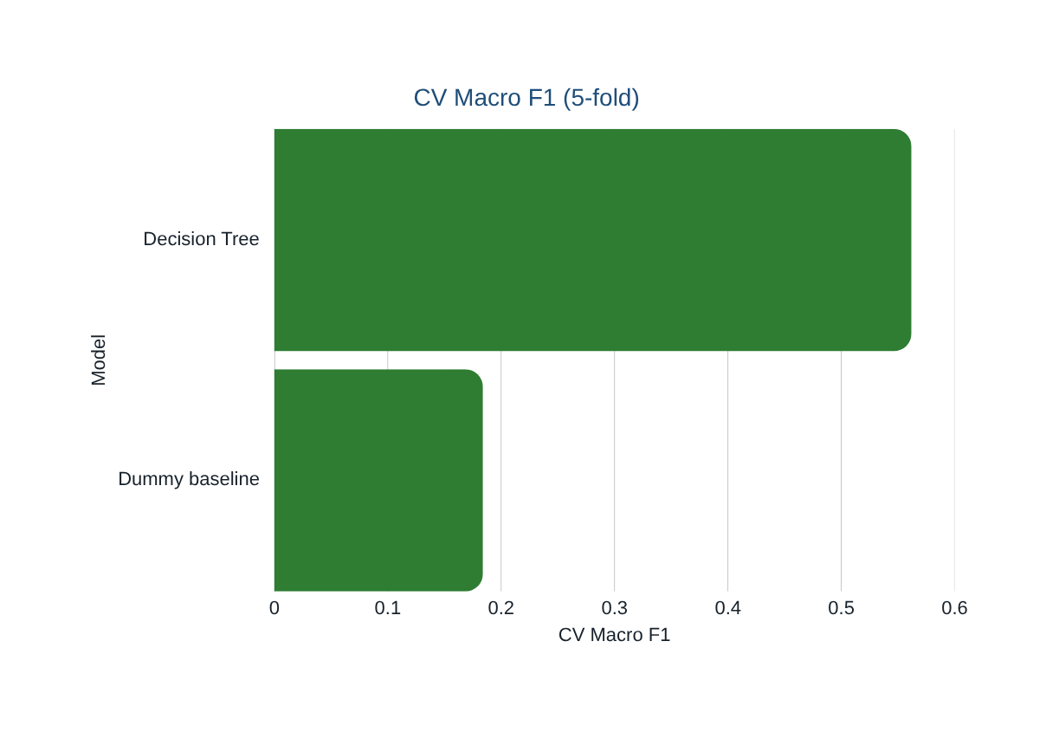
08
Real-Data Cross-Validation Results
REAL DATA
n=39
Decision Tree
CV Macro F1 0.562
Only values reported in the study are shown.
BCA FINAL-YEAR DEFENSE • XAVIER INTERNATIONAL COLLEGE
10
Notes:
Here we show the cross-validation results for the Decision Tree and the Dummy baseline.
The Decision Tree achieved a five-fold CV Macro F1 of 0.562. The Dummy baseline achieved 0.184.
So the Decision Tree clearly outperformed the baseline — 0.562 versus 0.184. This is our strongest cross-validation result. But cross-validation alone is not enough. We need to check held-out performance.
We only show two models on this slide because only the selected model and the baseline were evaluated on the held-out test set. This is deliberate — evaluating many models on the same small test set would risk overfitting to the test split."

Slide 11
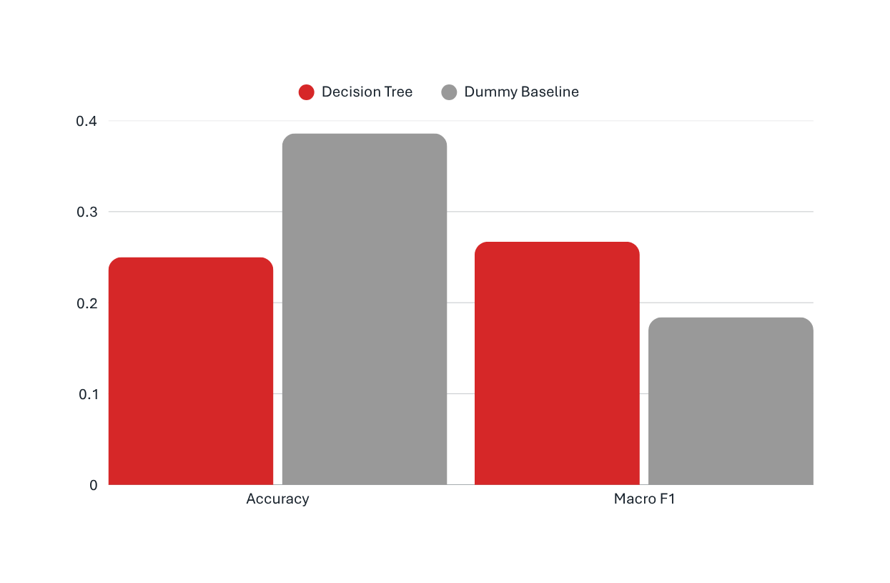
09
Real-Data Generalization Gap
HONEST FINDING
0.562 → 0.267
CV Macro F1 to held-out Macro F1
The strongest cross-validation result did not generalize to the held-out sample.
BCA FINAL-YEAR DEFENSE • XAVIER INTERNATIONAL COLLEGE
11
Notes:
"And here is the honest finding of our real-data experiment.
The Decision Tree achieved CV Macro F1 of 0.562. But when we evaluated it on the held-out test set of eight observations, the Macro F1 dropped to 0.267.
This is a substantial generalization gap. It indicates overfitting — the model learned patterns in the training data that do not transfer to unseen students.
With 31 training samples and 37 features, this is not surprising. The model has more degrees of freedom than data to constrain them. This finding drove our next experiment."

Slide 12
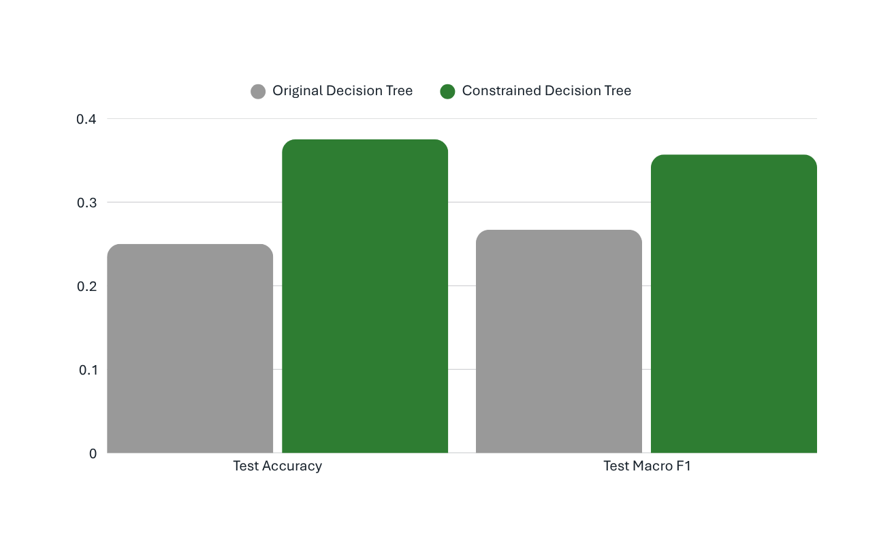
10
Constrained Decision Tree Experiment
max_depth=3
min_samples_leaf=3
+0.125
accuracy gain
+0.090
Macro F1 gain
BCA FINAL-YEAR DEFENSE • XAVIER INTERNATIONAL COLLEGE
12
Notes:
"To test whether we could reduce overfitting, we constrained the Decision Tree with maximum depth of 3 and minimum samples per leaf of 3.
On the same held-out test set, accuracy improved by 0.125, and Macro F1 improved by 0.090.
So the constraint helped. But we want to be careful — the test set has only eight observations. A single prediction changes accuracy by 12.5 percentage points. So this improvement is real on this split, but it should be treated as preliminary, not as proof that constrained trees are always better."

Slide 13
11
Synthetic Pipeline Validation (Validation Only)
LLM-GENERATED SYNTHETIC DATA
Methodological flaw — or insufficient sample size?
REAL
n=31
F1 0.267
SYNTHETIC
n=800
DELTA
reported comparison
+0.34 mean F1(0.366 → 0.701)
Synthetic dataset: 1,000 rows • 35 columns • Data_Source = Synthetic
Classes: Low 332 • Moderate 342 • High 326 • Train 800 / Test 200
Synthetic best model: Random Forest
BCA FINAL-YEAR DEFENSE • XAVIER INTERNATIONAL COLLEGE
13
Notes:
"Now the key diagnostic experiment. We wanted to know: was our poor real-data generalization because of methodology, or because of sample size?
To answer this, we ran the identical pipeline — the same preprocessing, the same seven models, the same evaluation — on a synthetic dataset of 1,000 rows generated by a Large Language Model.
The results are striking. On real data, the mean F1 across models was 0.366. On synthetic data, the mean F1 rose to 0.701. That's a 34-point improvement.
The best model on synthetic data was Random Forest, with F1 = 0.744. Interestingly, the best model on real data was Decision Tree — this suggests that model ranking is also sensitive to sample size.
The conclusion is clear: the pipeline is methodologically correct. Sample size, not methodology, is the primary constraint.
We must emphasize: the synthetic data is LLM-generated. It's used only for pipeline validation. We make no claims about real students from this experiment."

Slide 14
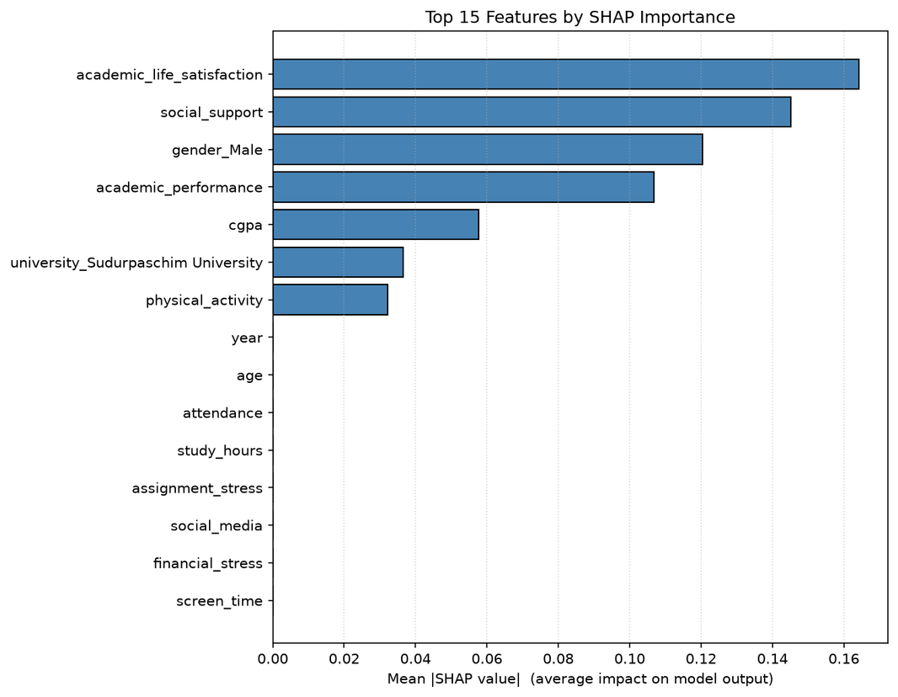
12
Explainability (SHAP) and Error Analysis
Top 7 features by mean absolute SHAP
Real data • Decision Tree
ERROR ANALYSIS
Small held-out sample
High feature-to-sample ratio
Cross-validation winner was unstable
The SHAP analysis identified academic life satisfaction, social support, and academic performance as the most influential features. Error analysis showed that all 6 held-out errors were between adjacent classes — never Low↔High. But the model was overconfident on wrong predictions, which is consistent with overfitting.
BCA FINAL-YEAR DEFENSE • XAVIER INTERNATIONAL COLLEGE
14
Notes:
"Next, we used SHAP to understand which features the Decision Tree was using.
The top features by mean absolute SHAP value were: academic life satisfaction, social support, gender, academic performance, and CGPA.
However, we treat these as exploratory, not causal. Some features — like 'university Sudurpaschim' — may appear important just because the sample has very few students from that category. We don't claim SHAP reveals causal relationships.
On error analysis: the model made six errors on the eight held-out observations. Importantly, all six errors were between adjacent classes — either Low↔Moderate or Moderate↔High. We never confused Low with High. This suggests the model's class ordering is meaningful, even though its accuracy is weak.
But we also found the model was overconfident — mean confidence on incorrect predictions was 0.945. This is another sign of overfitting."

Slide 15
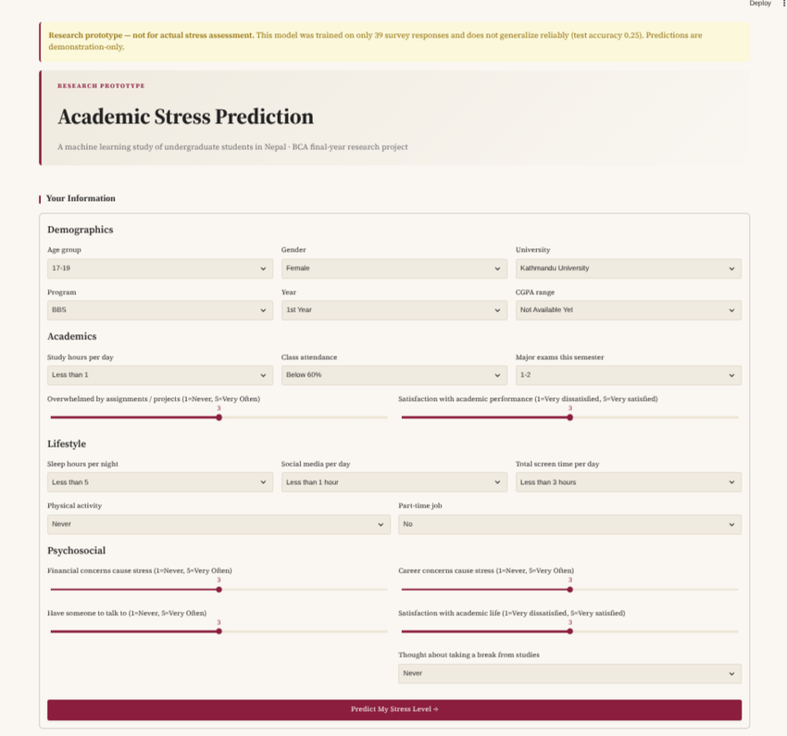
13
Streamlit Prototype
ACADEMIC STRESS
PREDICTION
Student information
Academic factors
Lifestyle factors
Psychosocial factors
BCA FINAL-YEAR DEFENSE • XAVIER INTERNATIONAL COLLEGE
15
Notes:
"Finally, we delivered a Streamlit research prototype. This is the practical output of the project.
Users enter 21 pieces of information — demographics, academic habits, lifestyle, and psychosocial factors. The application loads the trained Decision Tree and the fitted scaler, and returns a predicted stress level: Low, Moderate, or High.
The prototype also generates personalized stress-reduction suggestions based on the user's specific answers. It displays the Nepal Mental Health Helpline number, and it can store anonymous responses in a local SQLite database for future research.
Critically, the prototype is a research demonstration — not a diagnostic tool. Every screen displays a warning that the model is unreliable and not intended for clinical or high-stakes decisions. This is deliberate."

Slide 16
14
Conclusion and Future Work
CONCLUSION & LIMITATIONS
FUTURE WORK
A leakage-safe pipeline was implemented, but the real dataset did not support reliable held-out generalization. Constraining the tree improved both test metrics.
•Collect 300–500 genuine responses• Deploy the Streamlit prototype publicly to accelerate data collection via SQLite
• Re-run the pipeline once sufficient real data is collected
•Investigate feature reduction and regularization
•Perform external validation across institutions
• End-to-end leakage-safe pipeline implemented
• Real-data CV F1 = 0.562; held-out F1 = 0.267
• Constrained tree (max_depth=3, min_samples_leaf=3)
improved held-out F1 to 0.357
• Controlled synthetic experiment (n=1,000):
mean F1 = 0.701
• Isolates sample size — not methodology — as
the primary constraint
BCA FINAL-YEAR DEFENSE • XAVIER INTERNATIONAL COLLEGE
16
Notes:
"To conclude:
Our final selected model is the Decision Tree classifier, trained on 39 genuine responses. We built an end-to-end, leakage-safe pipeline from survey data through to a working Streamlit prototype.
The real-data experiment showed weak held-out generalization: CV F1 of 0.562, held-out F1 of 0.267. Constraining the tree improved held-out F1 to 0.357.
The synthetic validation experiment demonstrated that with 10 times more data, the same pipeline achieves F1 above 0.70. This confirms that sample size, not methodology, is the primary constraint.
For future work, our priority is to collect 300–500 genuine responses and re-run the pipeline. We also plan to deploy the Streamlit prototype publicly to accelerate data collection.
Thank you. We're happy to take questions."

Slide 17
THANK YOU
Questions & Discussion
Santosh Shrestha • Saroj Lamichhane
Supervisor: Sulav Shrestha
Xavier International College, Tribhuvan University

